Slide 1
Millet Disease Detection using Deep Learning
Nilanjana Jaysi (17100029)
Pratik Gupta (17100033)
Saanika Gupta (17100046)
Vinayak Bhartia (17101054)
Mentor : Dr. N. Srinivas Naik

Slide 2
Why millets?
Good for the consumer: they can help overcome some of the biggest nutritional and health problems (iron, zinc, folic acid, calcium, diabetes and more);
Good for the planet: they have a low water footprint, are able to survive in the hottest driest climates and will be important in coping with climate change, and more;
Good for the farmer: can increase yields up to 3 fold, have multiple uses(food, fodder, fuel), and are typically the last crop standing in times of drought being a good risk management strategy for farmers.

Slide 3
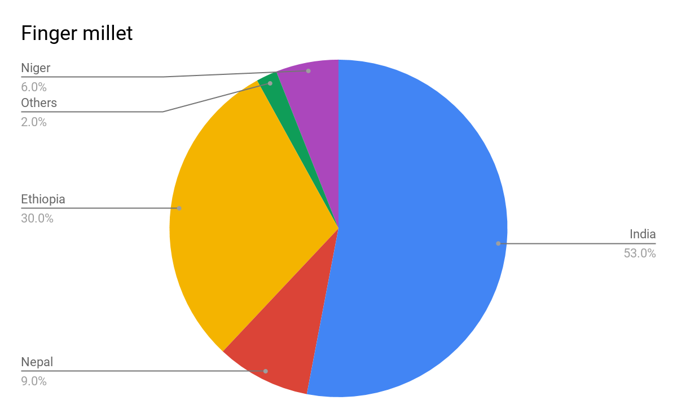
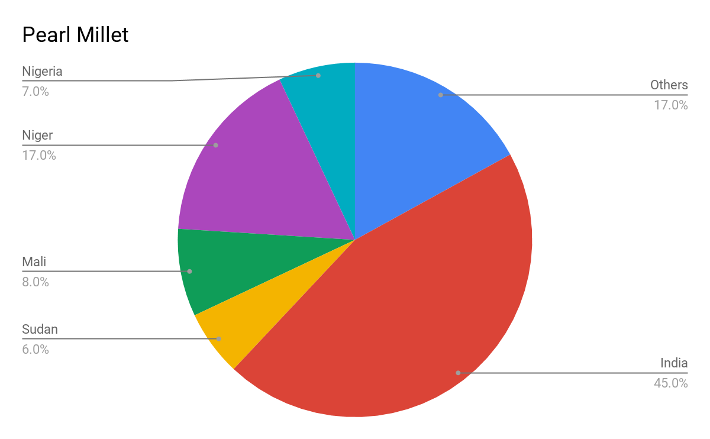
India- A major contributor to millets
Fig. 2. Contribution of Millet Crop in World [8]

Slide 4
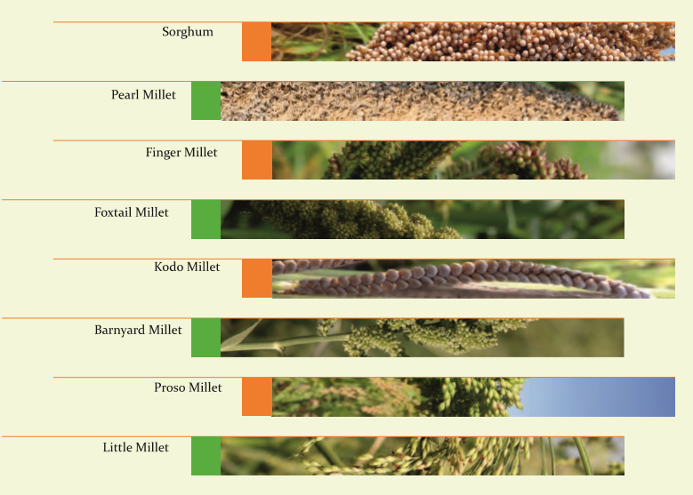
Types of Millets
Fig. 3. Types of Millets

Slide 5
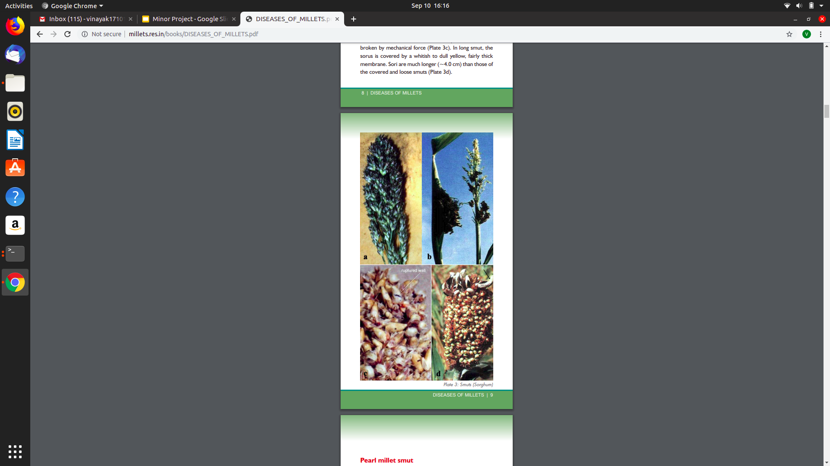
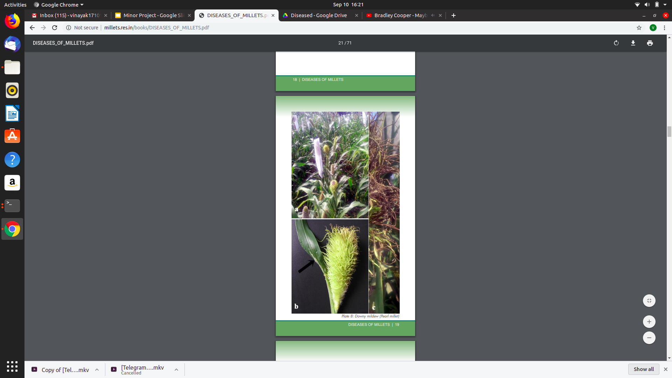
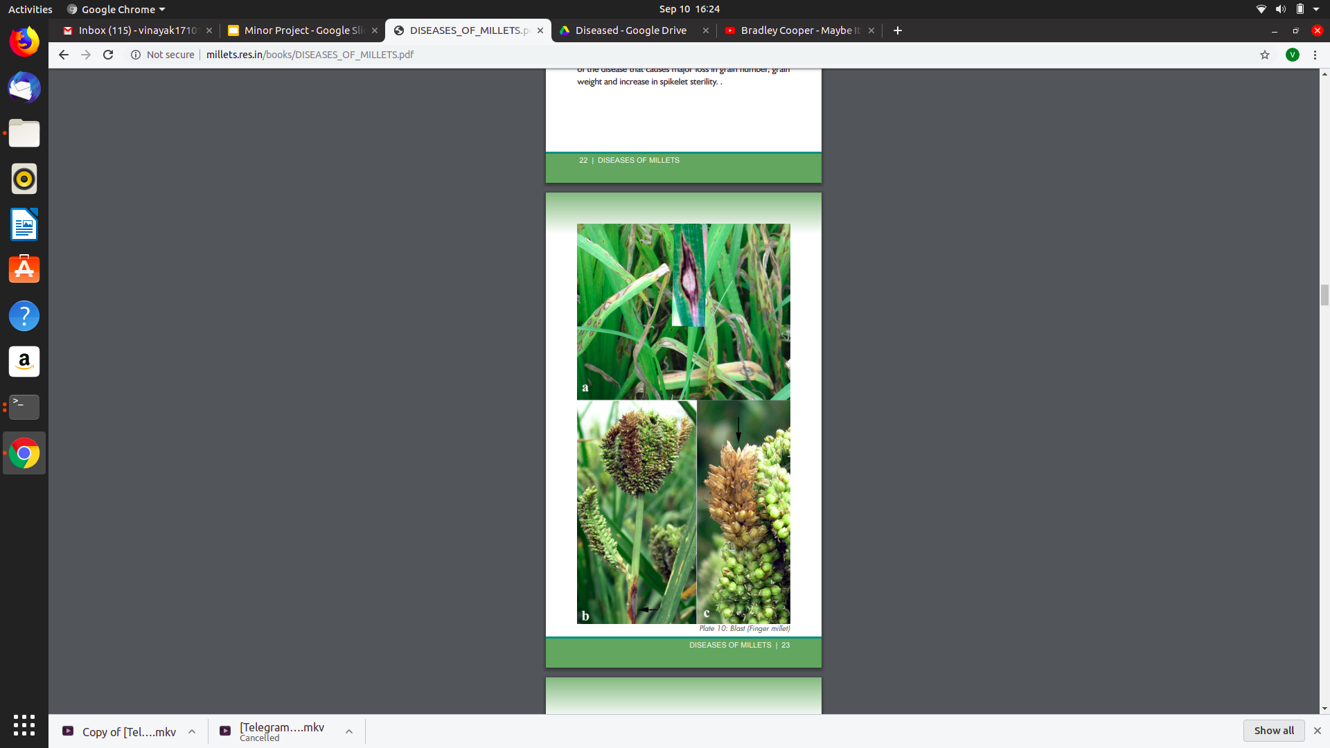
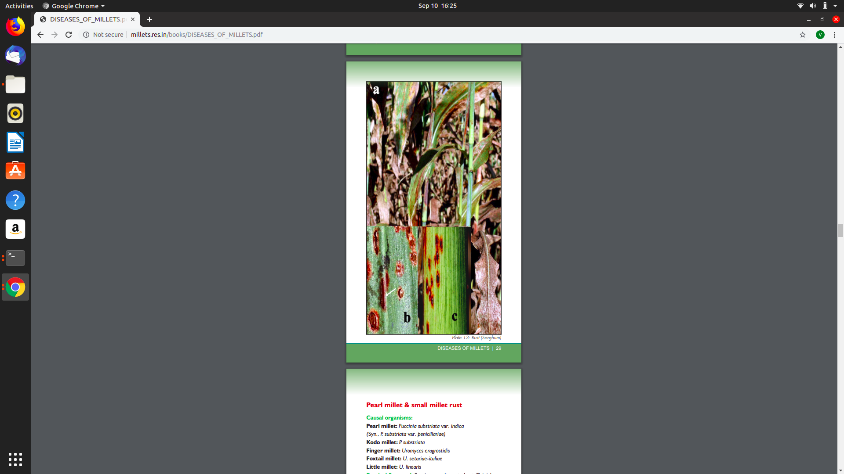
Diseases in Millets
Fungal Diseases
Smut-
Found in Sorghum, Pearl millet, Small millet
Downy mildew-
Found in Sorghum, Pearl millet, Small millets
Blast-
Found in Pearl millet, Finger, Foxtail, Barnyard, Proso & Little millets
Rust-
Found in Sorghum, Pearl millet, Small millets

Slide 6
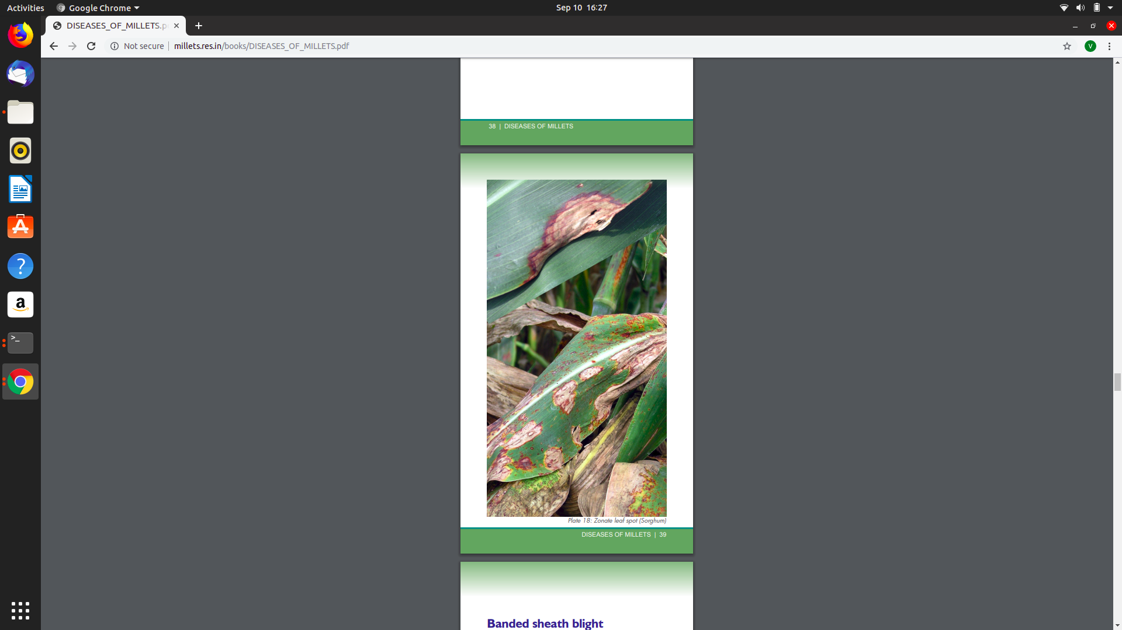
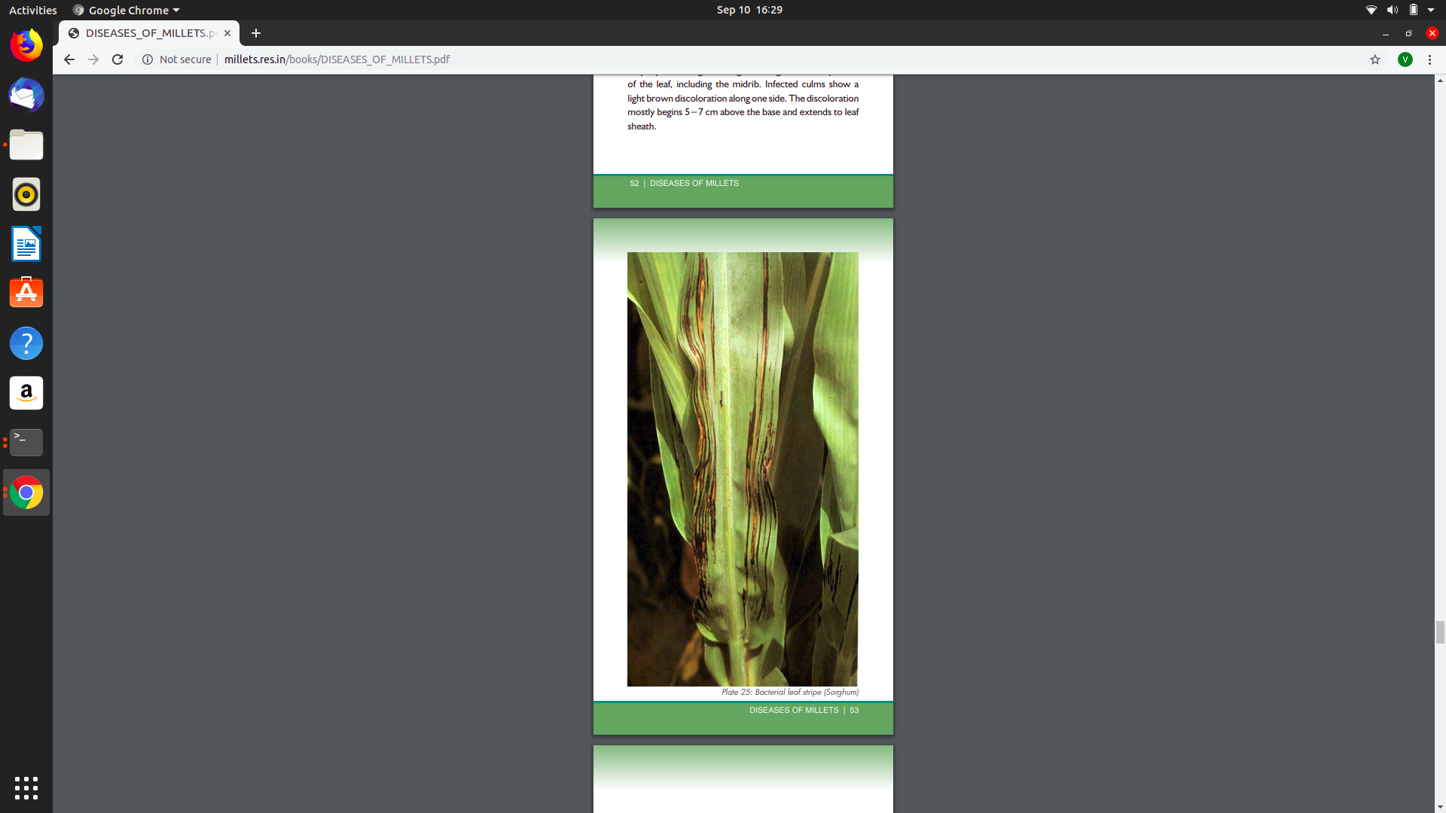
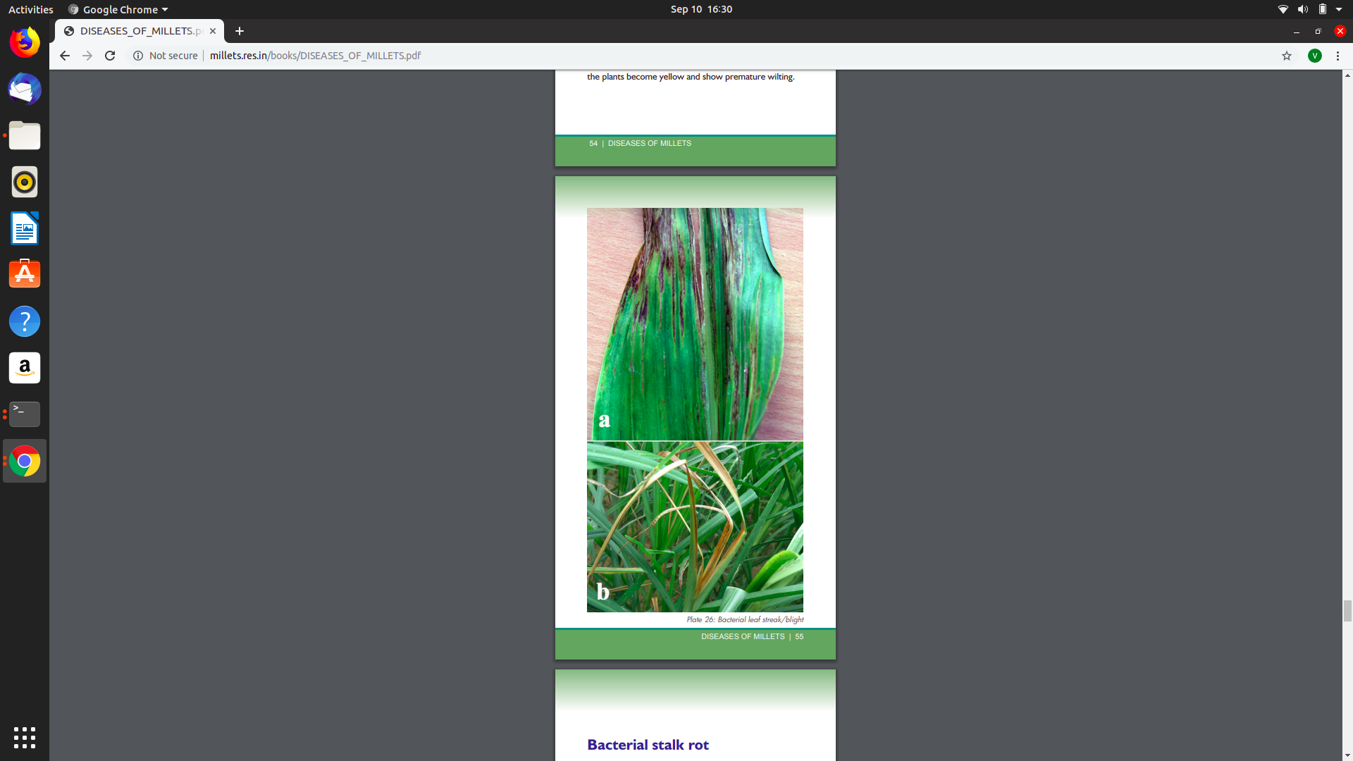
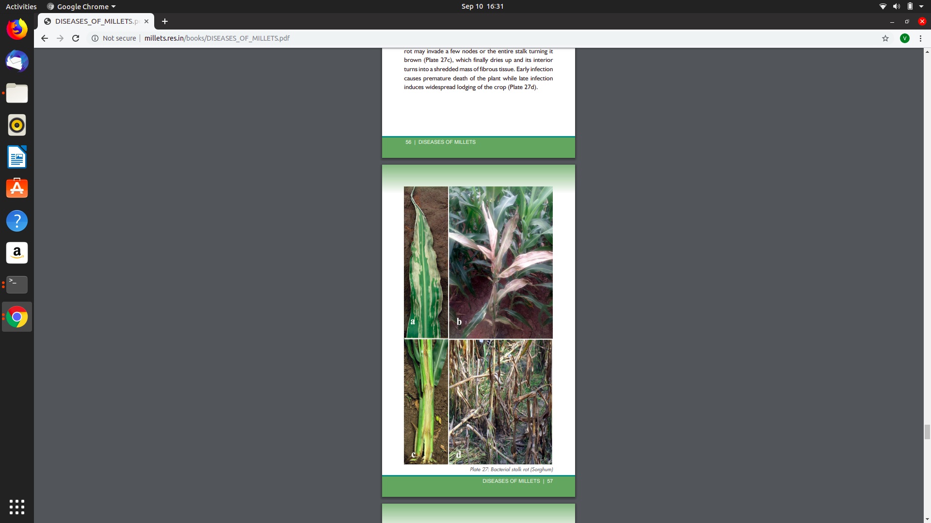
.
Bacterial Diseases
.
Bacterial leaf spot-
Found in Sorghum, Pearl millet, Finger millet
Bacterial leaf stripe-
Found in Sorghum, Pearl millet, Finger millet
Bacterial leaf streak-
Found in Sorghum, Pearl millet, Small millets
Bacterial stalk rot-
Found in Sorghum
.

Slide 7
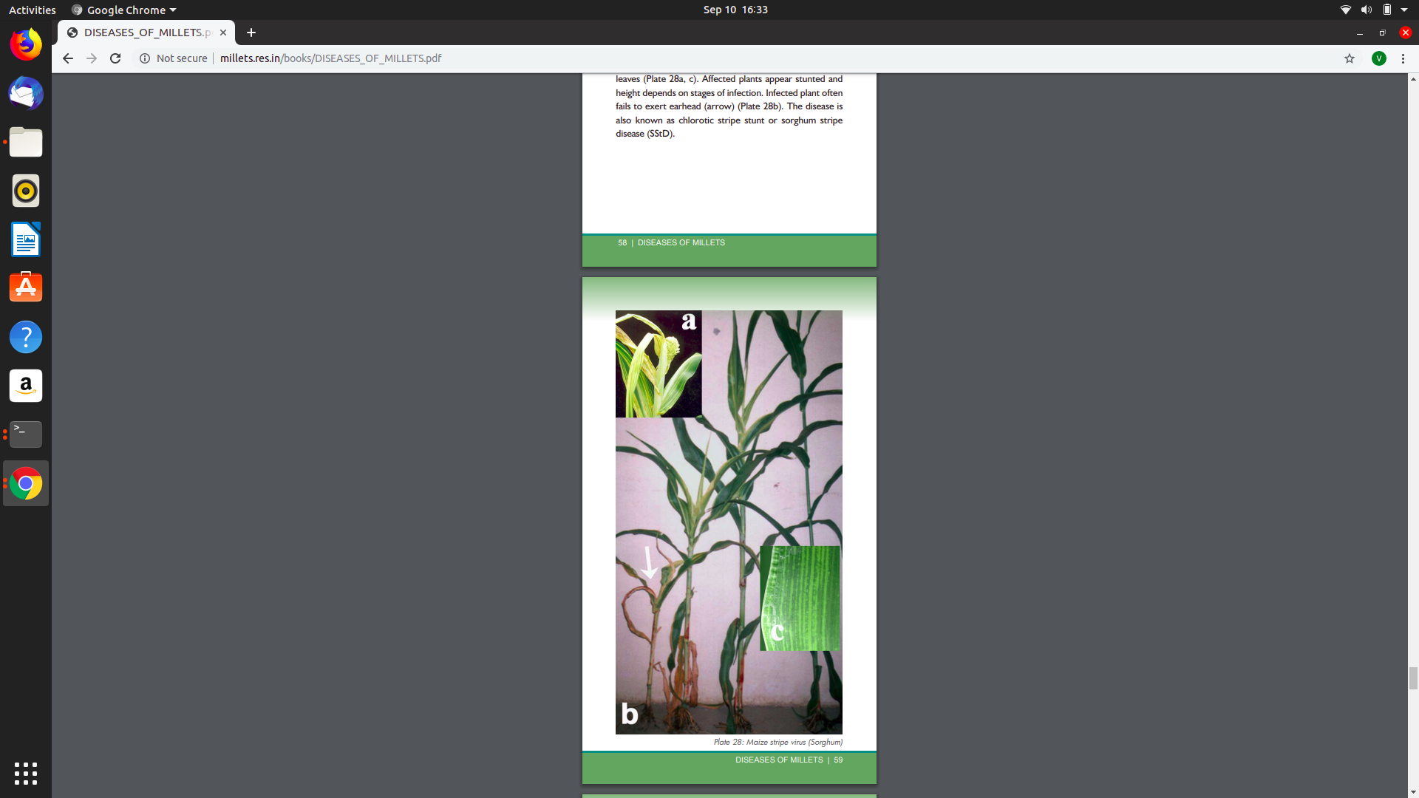
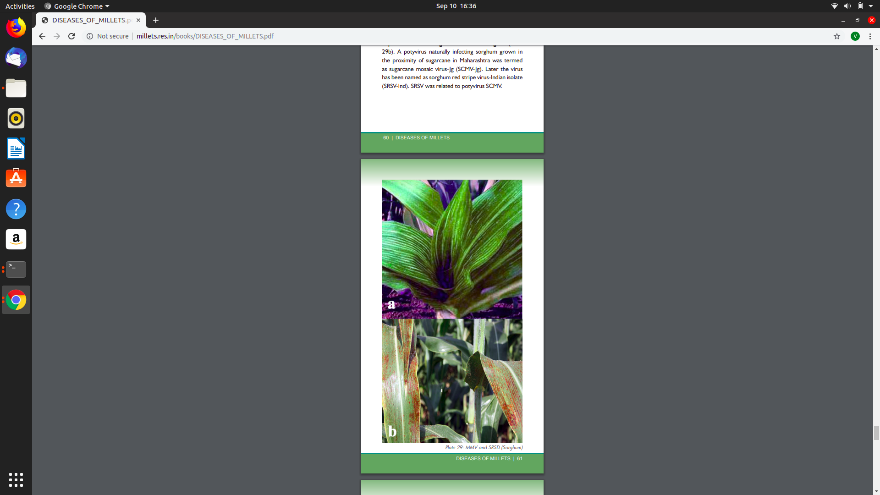
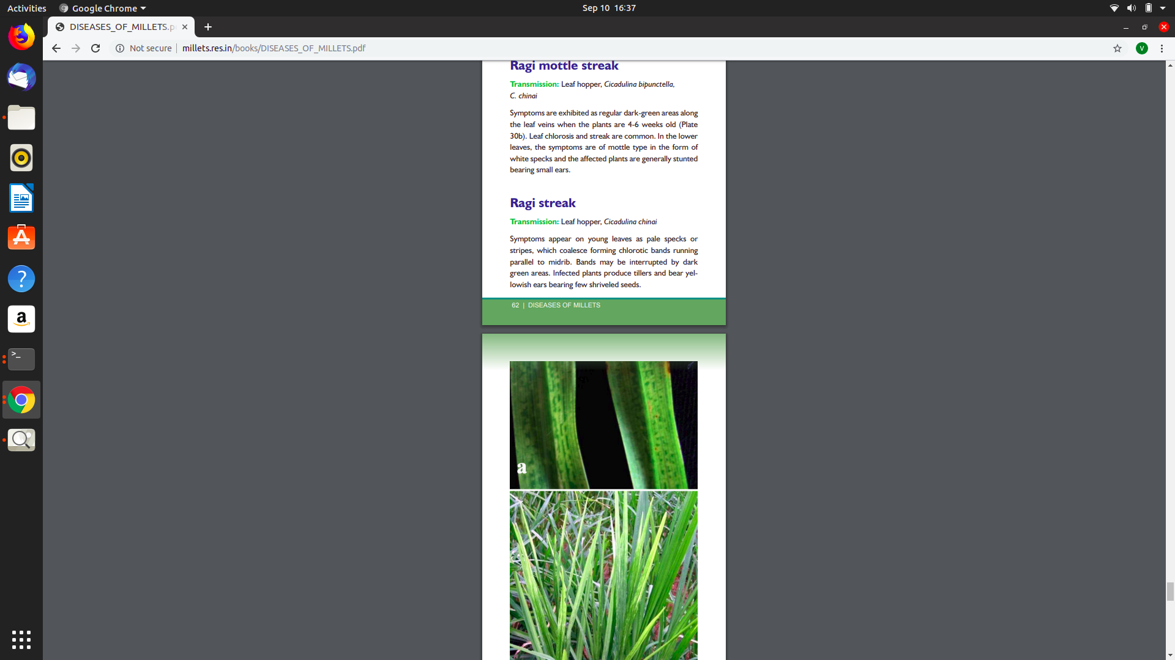
.
Viral Diseases
Maize stripe (MStV-S)-
Found in Sorghum, Pearl millet, Small millets
Maize mosaic (MMV-S)-
Found in Sorghum, Pearl millet, Small millets
Red stripe (SRSD)-
Found in Sorghum, Pearl millet, Small millets
Ragi severe mosaic-
Found in Sorghum, Pearl millet, Small millets
.

Slide 8
Problem Statement
To make a platform independent application which takes millet pictures as input and the disease is predicted (else healthy) by the proposed deep learning model (deployed on Django REST API). It also gives the output as the disease name and the methods which can be applied to cure the disease. The model is built using the GoogLeNet architecture.

Slide 9
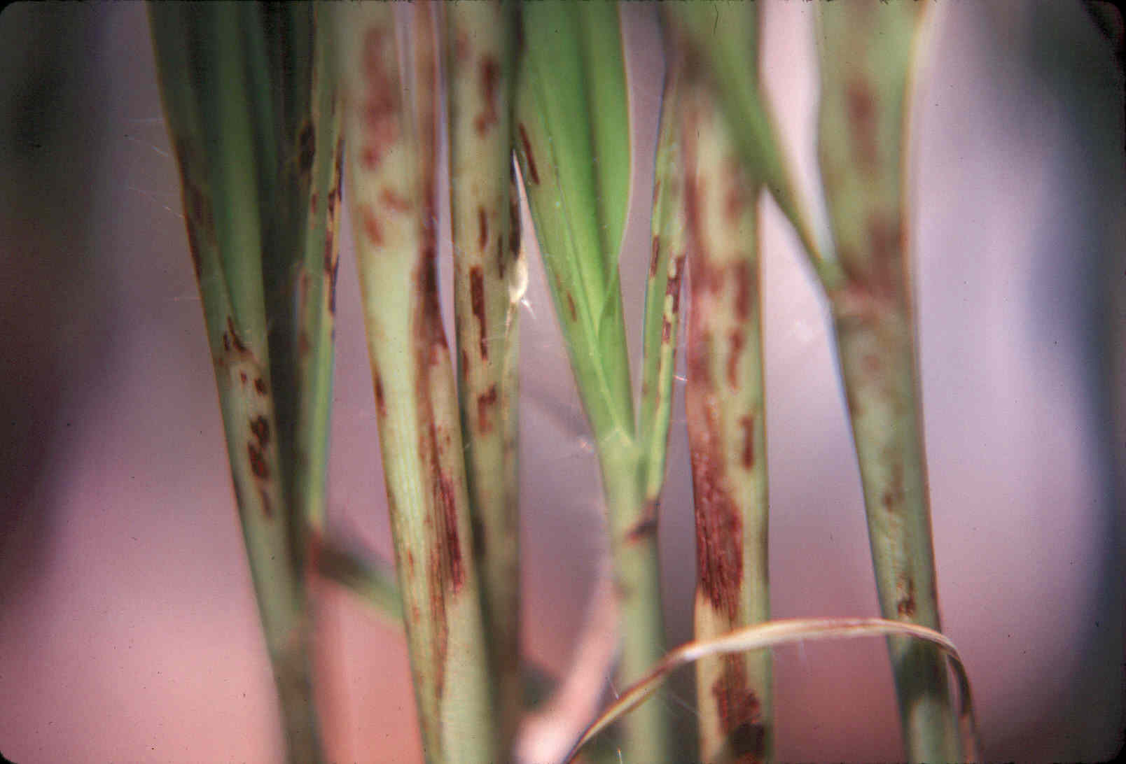
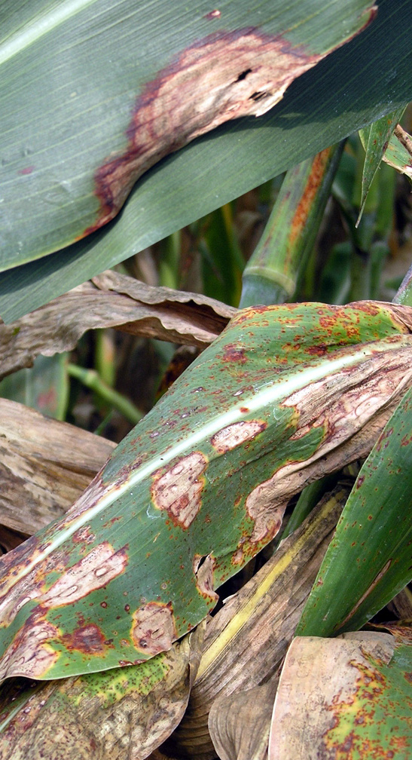
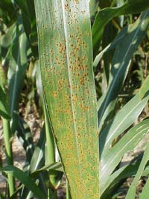
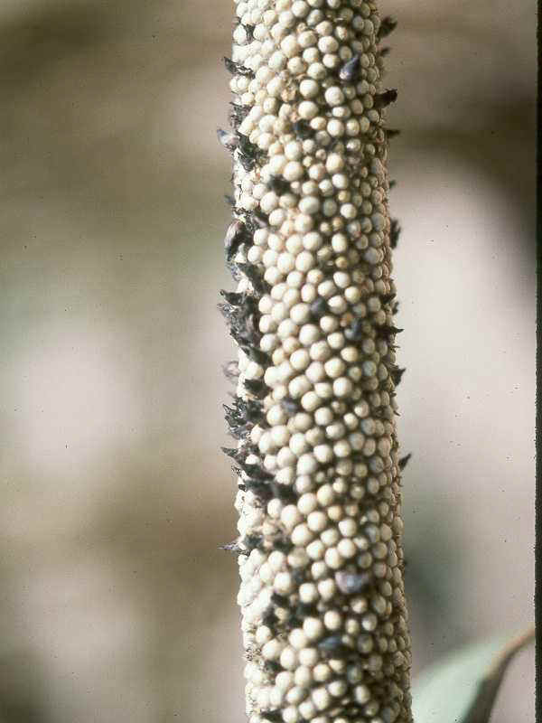
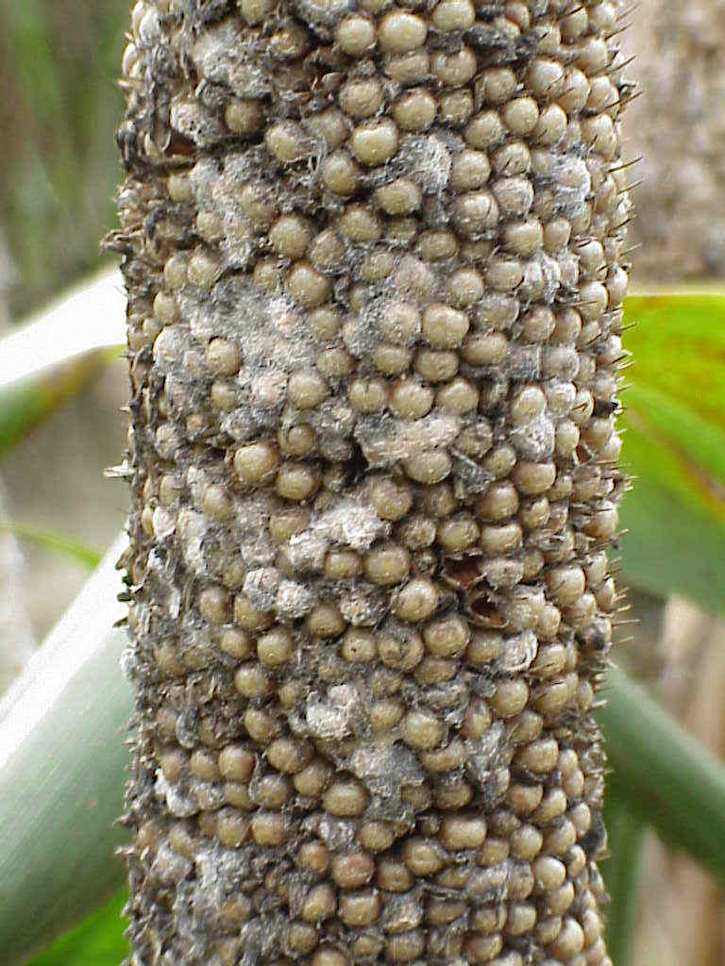
Common diseases
Bipolaris leaf spot
Ergot
Smut
Bacterial
Rust
Fig. 4. Common diseases in Millets

Slide 10
Literature Survey

Slide 11
PAPER I
Deep neural networks with transfer learning in millet crop images [February 2019]^{[1]}
Approach
Authors have presented a deep learning model to find diseased millet crops.
They have used transfer learning of pre-trained VGG16 convolutional neural network.
First a dataset is created from a small set of images of millets using augmentation(rotation or translation).
Then these images are fetched to create model via transfer learning on VGG16 model.
Feature extraction is used for transfer learning .i.e., features of the pre-trained model is used while it is trained on new dataset.
Upon testing, they were able to achieve a fair 95% accuracy
Limitations
Only one type of disease (mildew disease) can be detected using this system.
A small dataset of 124 images is used.
No image segmentation is done before training.
As pre-trained model is used feature selection is used, more appropriate features could have been selected by training a new model

Slide 12
PAPER II
Identification of plant leaf diseases using image processing techniques [February 2018]^{[2]}
Approach
The leaves are first pre-processed to improve the quality, dimension and to remove the background.
Then the image is segmented using K means clustering to get infected area. 3 clusters are obtained for each of the 3 channels of RGB.
Region of Interest is selected by the user from these 3 clusters.
Then the disease is predicted from the Support Vector Machine model .
Accuracy- 92%
Limitations
It is specifically trained for 5 diseases only.
Region of Interest is explicitly selected by user ie., not fully automated.
The training dataset is limited.
The model won't be able to deal with the leaves in natural scenario because its segmentation is done when image is in RGB channel while it is done better in YCbCr channel.

Slide 13
PAPER III
Leaf Disease Detection: Feature Extraction with K-means clustering and with ANN [August 2019]^{[3]}
Approach
Four stages- image acquisition, image segmentation, feature extraction and classification.
The authors have tried to detect leaf spot diseases in tomato and cotton leaves using segmentation and artificial neural networks.
Image segmentation is done with K-means clustering method and features are computed from disease affected cluster.
Features such as Contrast, Correlation, Energy, Homogeneity, Mean, Standard Deviation and Variance are extracted.
The extracted features from disease cluster are given as inputs to the Neural Network classifier.
It is observed that the accuracies for bacterial leaf spot and target spot of cotton leaf diseases as 90% and 80% respectively. For tomato leaf diseases- septoria leaf spot and leaf mold as 100%.
Limitations
Done for leaf spot, target spot, septoria leaf spot and leaf mold disease only that too in cotton and tomato only.
Images are not in the natural environment.
The disease affected cluster is selected by the user.
Accuracy is less (80% in some case), perhaps different features has to be considered
Number of training images were less(20 for each of tomato and cotton disease).

Slide 14
PAPER IV
Deep Neural Networks Based Recognition of Plant Diseases by Leaf Image Classification [May 2016]^{[4]}
Approach
Five stages - Image preprocessing and labelling, augmentation process, neural network training, performed test and fine tuning.
Images were downloaded from internet. Procedure of image processing involved cropping of all the images manually, making the square around the leaves, in order to highlight the region of interest.
Augmentation was applied to increase the dataset and introduce slight distortion to the images which helps in reducing overfitting during the training stage..
Caffe, an open source deep learning framework was used, along with the set of weights learned on a very large dataset, ImageNet.
For the accuracy test, 10 fold cross validation technique was used to evaluate a predictive model. On average, the accuracy of classification using this approach was 94.67%.
To start the fine tuning procedure, the previous softmax classifier was removed and the new one was initialised and trained using the back propagation algorithm.
Limitations
The trained model accuracy was less for classes with lower number of images in the training dataset.
The method relied too much on the augmented data as they are converting the 3000 images original dataset into 30,000 images.
The model didn’t use the real world example of the images of leaves.

Slide 15
PAPER V
Using Deep Learning for Image-Based Plant Disease Detection [September 2016]^{[5]}
Approach
The authors have trained a deep convolutional neural network to identify 14 crop species and 26 diseases. It presents a clear path towards a smartphone assisted crop disease diagnosis on a massive global scale.
They have used three different versions of the whole PlantVillage dataset i.e. gray-scaled version, colored version and finally the dataset formed by removing all the extra background information which might introduce inherent bias in the dataset.
Segmentation was automated by the means of a script tuned to perform well the PlantVillage dataset which is based on a set of masks generated by analysis of the color, lightness and saturation components of different parts of the images in several colour spaces (Lab and HSB).
To verify that there is no overfitting, the author run all the experiments across a whole range of train-test splits, from 80-20 till 20-80.
AlexNet and GoogleNet architecture of deep convolutional networks for the classification problem is used. Transfer Learning and Training from Scratch is used for training mechanism.
Limitations
When tested on a set of images taken under conditions different from the images used for training, the model’s accuracy is reduced substantially, to just above 31%. Hence, a more diverse set of training data is needed to improve the accuracy.
The approach is currently constrained to the classification of single leaves, while a real world application should be able to classify images of a disease as it presents itself directly on the plant. Indeed, many diseases don’t present itself on the upper side of leaves only. Hence, new image collection efforts should try to obtain images from many different perspectives.

Slide 16
First Author, Year | Approach | Limitations
Coulibaly, 2019 [1] | Image augmentation VGG16 pre-trained model | Only one type of disease. No image segmentation is there.
Pooja, 2017 [2] | K-means clustering Support vector machine | Not fully automated. Segmentation can be improved using YCbCr channel.
Kumari, 2019 [3] | K-means clustering segmentation Artificial neural network | Limited dataset Limited number of diseases
Sladojevic, 2016 [4] | Leaf Image Classification Convolutional Neural Network based plant disease detection | Giving poor results for diseases having less data sample. Heavily dependent on augmentation.
Mohanty, 2016 [5] | Segmentation of leaf image AlexNet for detection of plant disease | No good results on real time dataset. Only limited to diseases that can be found at the top of the leaves.
Table 1. Literature Survey

Slide 17
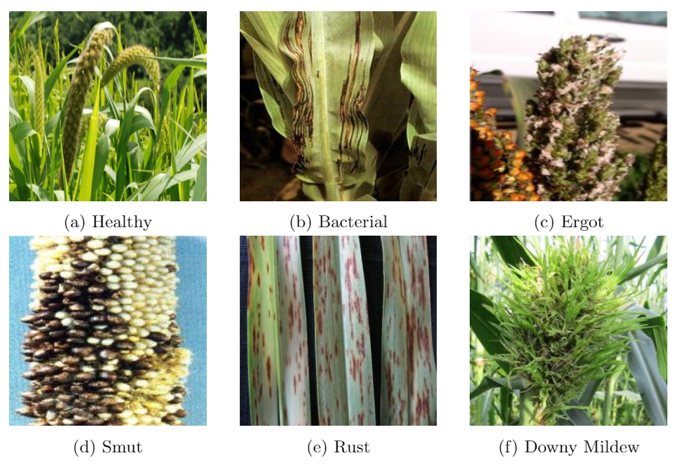
Proposed Work and Methodology
Our proposed solution for detecting diseases in millet crops followed the following steps:
Image Acquisition- Collecting images from different sources such as Google, Facebook and different other websites.
Fig. 1: Acquired Images

Slide 18
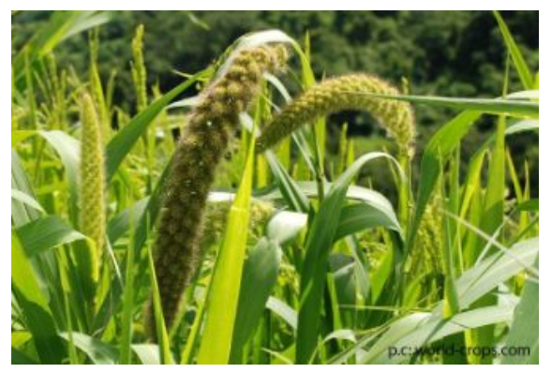
Augmentation- Increasing the number of images by performing different augmentation techniques such as rotation, enlargement etc. on the available dataset.
Fig. 2: Original Image

Slide 19
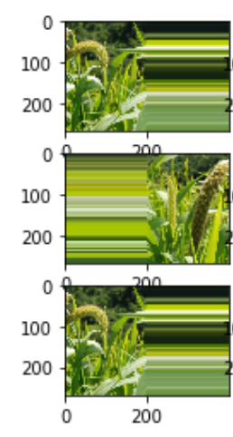
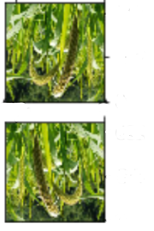
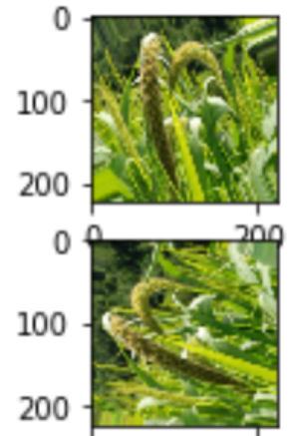
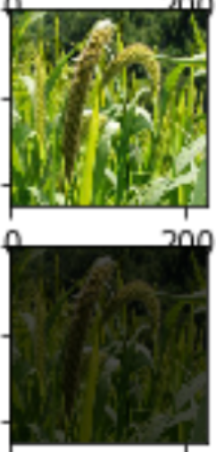
(a) Shifting (b) Flipping
(c) Random Rotation
(d) Random Brightness
Fig. 3: Augmentation Techniques

Slide 20
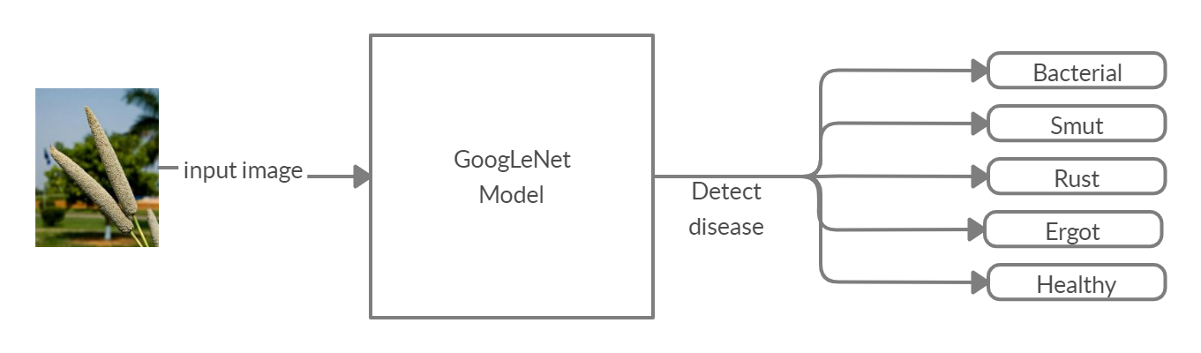
Model Construction- After training the dataset on different architectures such as a simple CNN, VGG15, VGG16, AlexNet, ResNet, GoogLeNet, the best result was obtained from GoogleNet.
Fig. 4: Block Diagram of Proposed Model

Slide 21
GoogLeNet [6] Architecture
It is a widely used architecture for ImageNet dataset (1000 classes).
It takes as input an image of dimension 224 x 224 x 3 and returns a vector of size 1,000 with probabilities belonging to each class.
It is 22 layers deep with 9 inception modules and 5 pooling layers.
Inception module for dimensionality reduction and to avoid overfitting.
Intermediate softmax branches are only used for training and helps combating vanishing gradient problem.

Slide 22
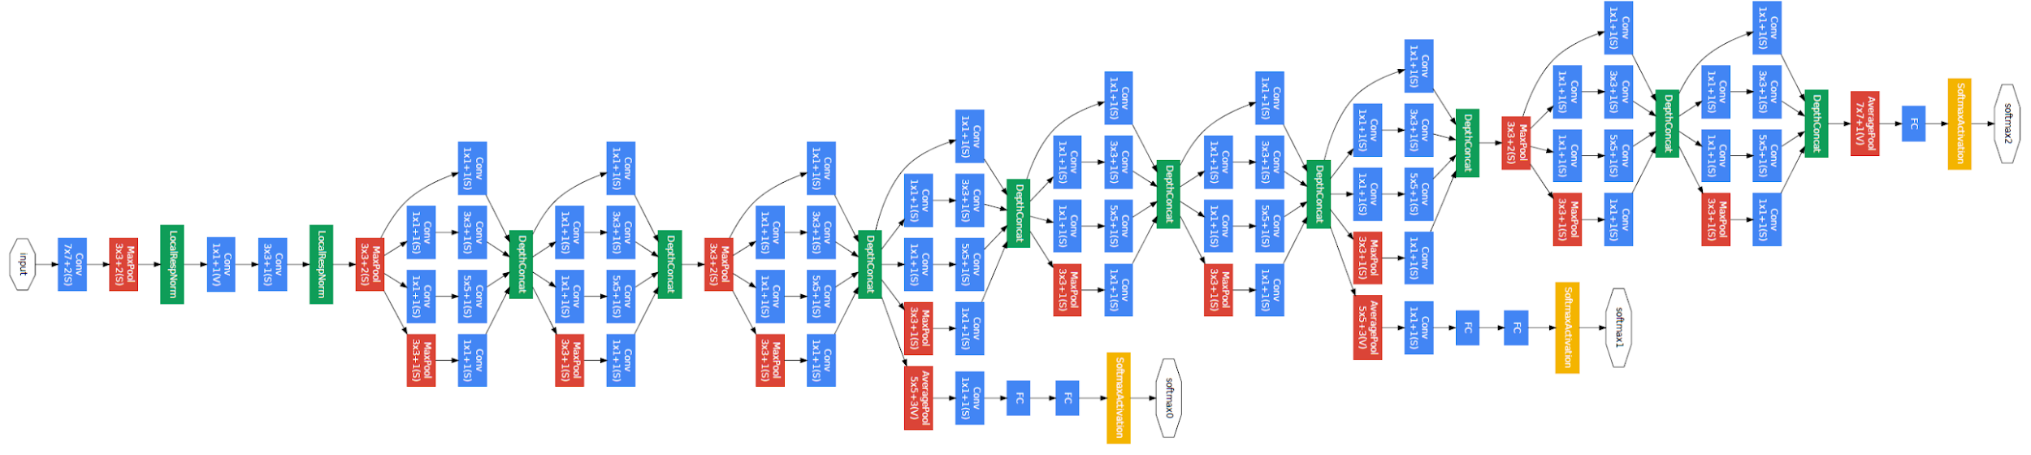
GoogLeNet Architecture
Fig. 5: GoogLeNet Architecture [6]

Slide 23
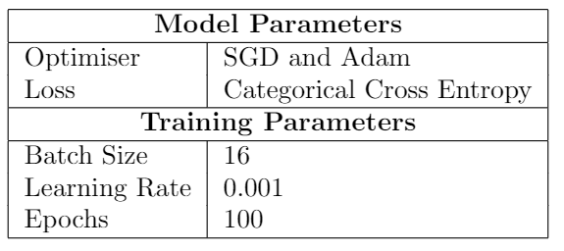
Table 2. Parameters of GoogLeNet Architecture

Slide 24
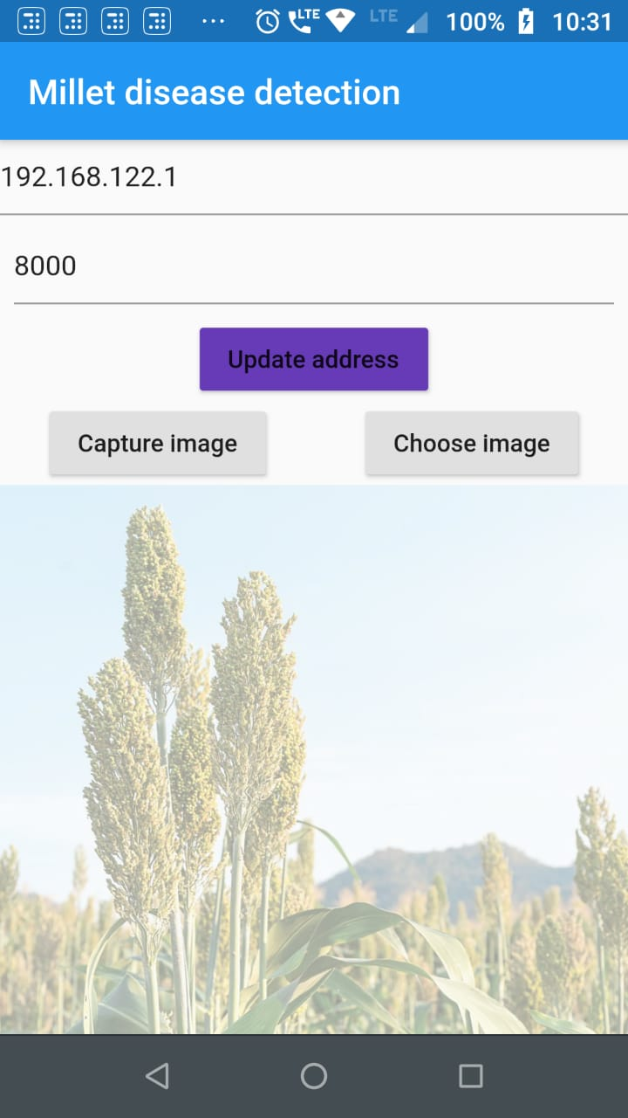
Deployment
The complete system broadly consists of two components:
A mobile application to capture and send the image of millet.
A server, where model is hosted, to identify the disease.
Made using Flutter.
Provides two options- capture or select from the gallery.
Capture and send
Receive response
Show disease with solutions
Fig. 6: App

Slide 25
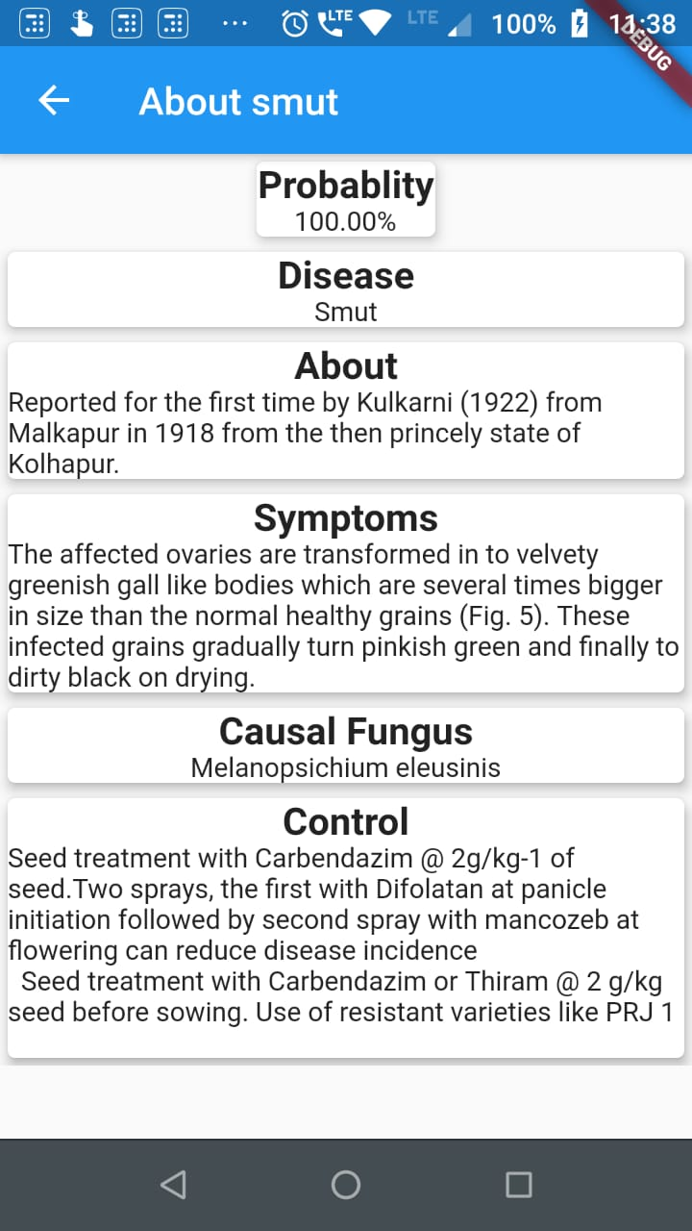
Working of the server(REST API)
Receive and detect millet
Find disease
Send response
Receive the millet image from a post request in the Django REST API and check if millet is present in the image or not using ResNet model.
If millet is present in the image, then it is checked for disease using our fine-tuned GoogLeNet model.
The disease detected is sent as a response back to application along with probability of decision.
Fig. 6: Detection and Suggestions

Slide 26
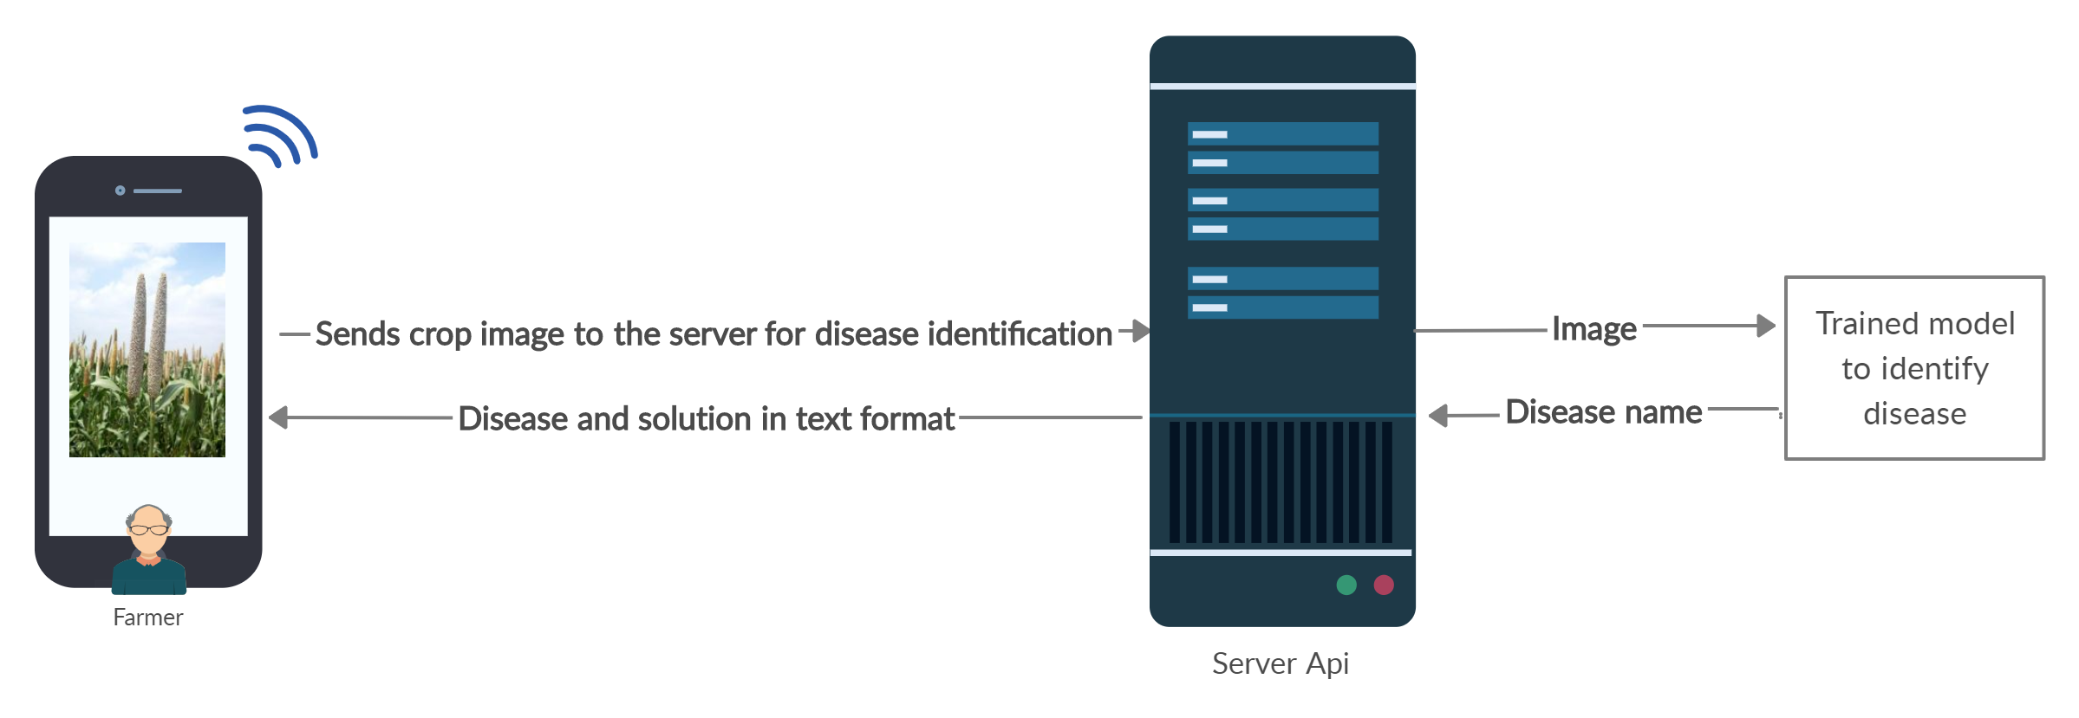
The Current Prototype
Fig. 8: Current Prototype

Slide 27
Results
Five-way classification accuracy - 81.4%
The app is able to classify between healthy, ergot, rust, smut and bacterial diseases well enough in the real-environment scenarios.
The app also identifies if the taken picture is actually a crop image or any other object.

Slide 28
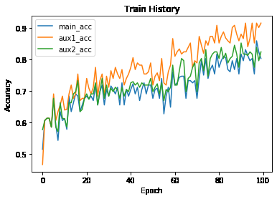
Fig. 9: Train History of Accuracy

Slide 29
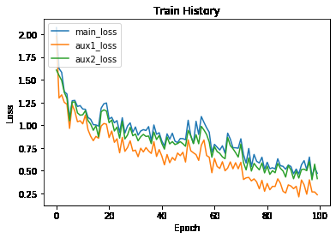
Fig. 10: Training History of Loss

Slide 30
Limitations
Since the model is integrated inside a server, it takes around 4-5 seconds to load the model and predict the result for the image.
Since most of the downy mildew disease pictures resemble a healthy millet crop, hence it is being predicted as healthy.
As the viral dataset is small, its corresponding accuracy is very less.

Slide 31
Conclusion
We trained a GoogLeNet architecture from scratch using Adam and SGD optimizers alternatively for a five-way classification task.
This trained model is deployed on Django REST API.
The output classes are healthy, ergot, smut, rust and bacterial.
In case a disease is detected, the app shows an screen with remedy else it pops up a dialog box with the corresponding message.

Slide 32
Future Work
Collecting a large dataset by field work.
Integrating the model inside the app so that it can be used anytime anywhere.
Replying the user with regional voice message.
Further optimising the app and feeding more info about the diseases and methods of curing them so that the app suggests the best possible way to keep the crops healthy and free from any kind of infection or illness.

Slide 33
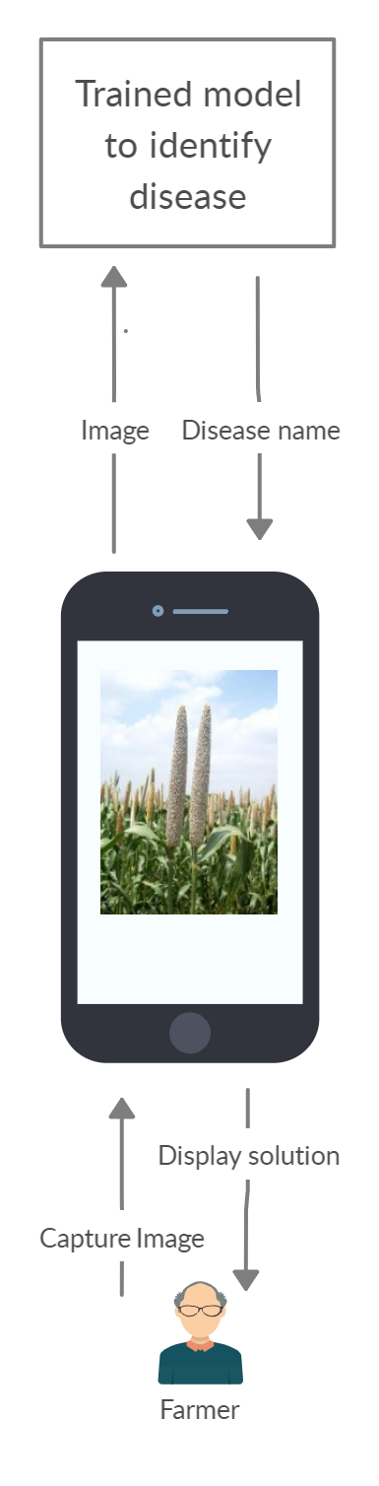
Fig. 10: Future Work

Slide 34
Implementation of Paper I [1]
The implemented model uses the feature extraction.
Feature extraction is the process of transforming the raw pixel values from an image, to a more meaningful and useful information that is in machine learning.
Feature extraction is an approach of transfer learning.
We have used a pre-trained convolutional neural network (VGG16) for the classification of ‘healthy’ and ‘diseased’ millet crops.
The algorithms of deep learning require a large dataset and a long time to train those millions of parameters of deep network. Hence transfer learning is used.

Slide 35
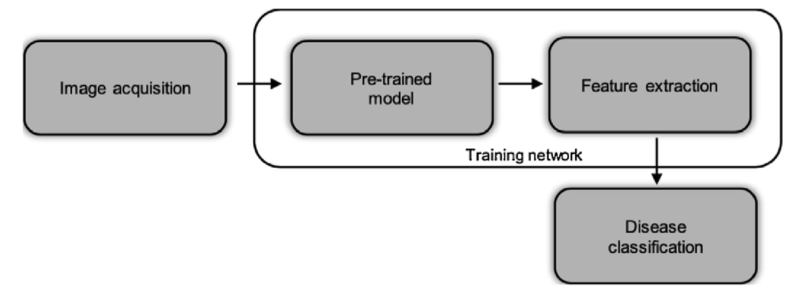
Overview of the implementation
Fig. 5. Flowchart of the implementation process [1]

Slide 36
Pre-trained Model used - VGG16
The VGG16 is proposed by [6].
It is a widely used architecture for ImageNet dataset (1000 classes).
It takes as input an image of 224 x 224 px and returns a vector of size 1,000 with probabilities belonging to each class
VGG16 contains 13 convolution layers, 3 fully connected layers and 5 pooling layers (as shown in Fig. 6).
The convolution layers are used for feature extraction.
Multiple kernels of dimension 3 x 3 with 1px as a stride are used.
ReLU is applied as an activation function.
Softmax activation is used in the last layer for probability distribution of the classes.

Slide 37
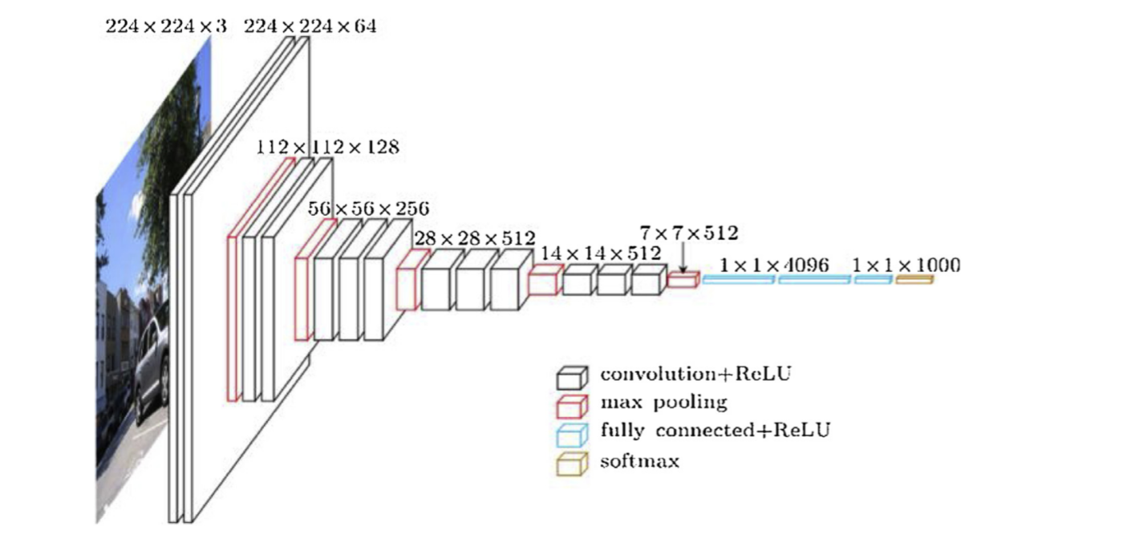
VGG16 Architecture
Fig. 6. VGG16 Architecture [6]

Slide 38
Transfer Learning
Deep CNNs have millions of parameters and training them from scratch often requires large amounts of computing resources.
Transfer learning [7] shortcuts much of this as it makes use of the knowledge gained while solving one problem and applying it to a different but related problem.
The new dataset helps to fine tune the pre-trained VGG16 to transfer the knowledge.
Transfer learning is beneficial when new dataset is smaller than the original dataset used to train the pre-trained model.

Slide 39
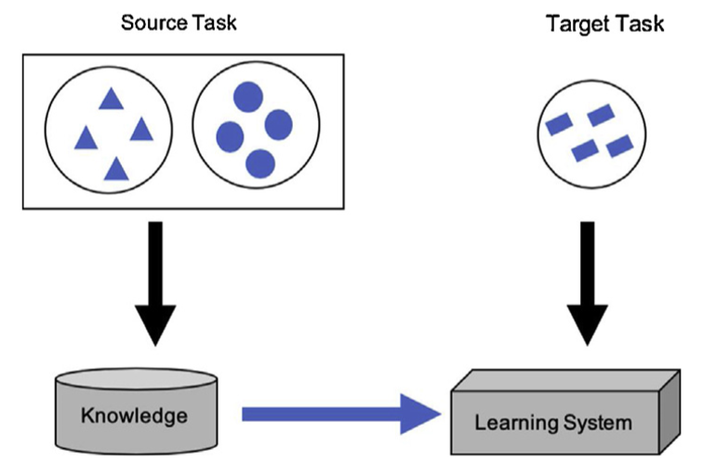
Transfer Learning
Fig. 7. Transfer Learning Block Diagram [1]

Slide 40
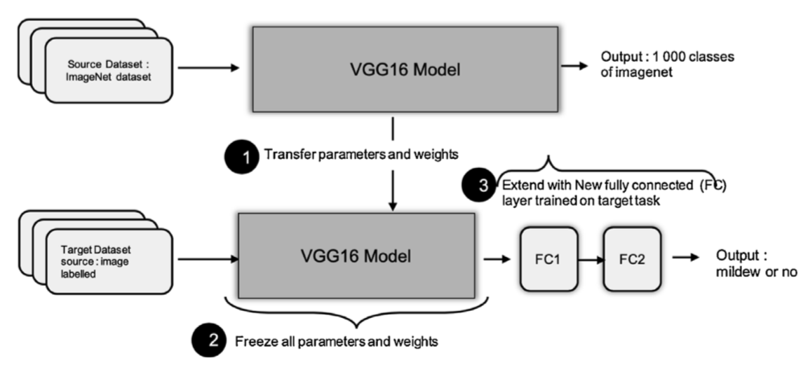
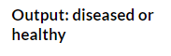
Approach for feature extraction
Fig. 8. Block Diagram for Feature Extraction [1]

Slide 41
Model Parameters
Model Parameters
Optimizer | Stochastic Gradient Descent (SGD)
Loss | Binary Cross Entropy
Training Parameters
Batch Size | 5
Learning Rate | 0.0001
Epochs | 20
Table 2. Literature Survey

Slide 42
Model Evaluation
True/Predicted | Healthy | Diseased | Accuracy (%)
Healthy | 19 | 1 | 95.00
Diseased | 2 | 13 | 86.67
Total | 21 | 14 | 94.28
Table 3. Confusion Matrix

Slide 43
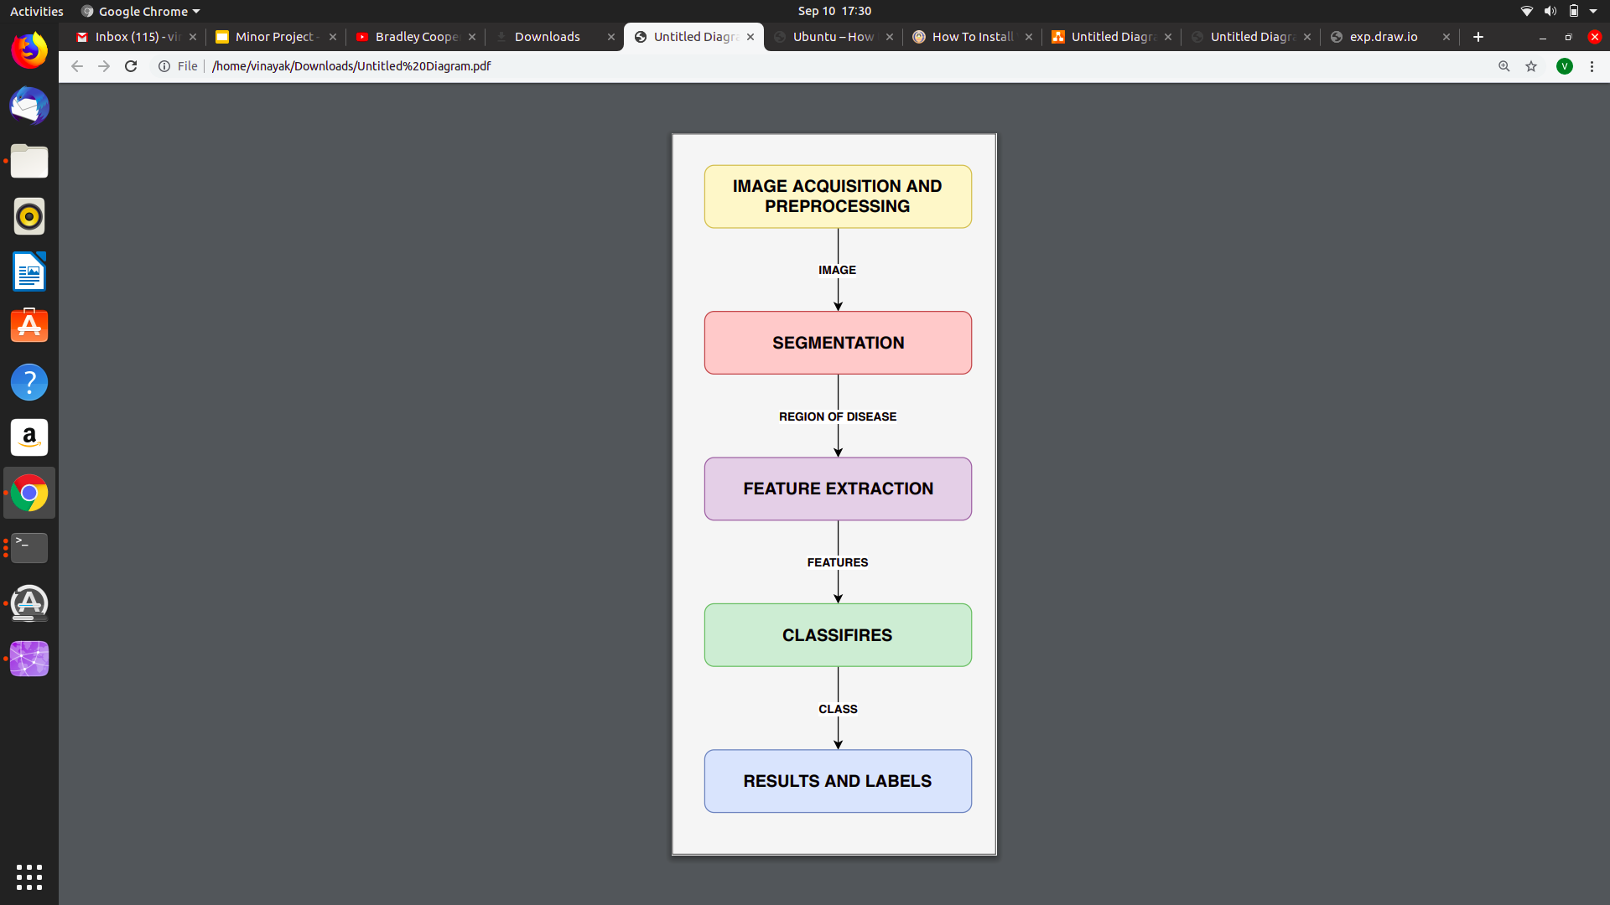
Proposed Solution
Experiments to be carried out
Collecting more diverse dataset consisting of real environment scenario.
Using Image Processing techniques to separate relevant background and foreground.
Trying out different pre-trained models (AlexNet, GoogleNet, SNet, VGG19) and fine tuning them.
Training mechanisms to be experimented
- Training from Scratch
- Transfer Learning
Fig. 9. Flowchart of the Proposed Solution

Slide 44
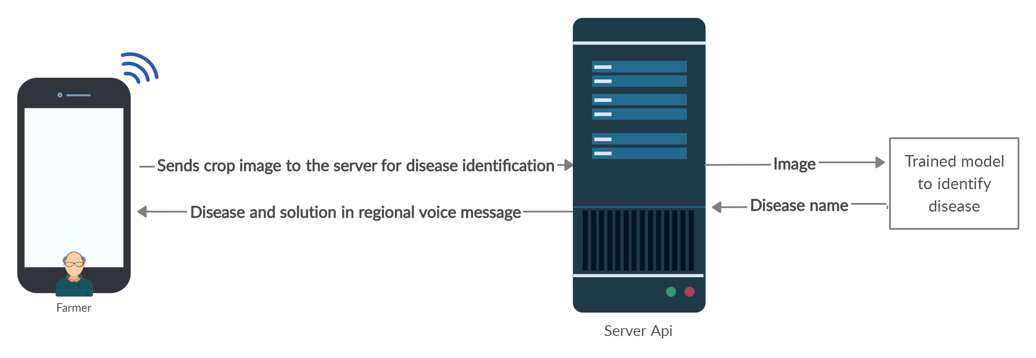
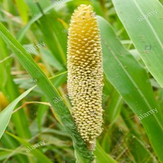
Future Work
(1)
(2)
(4)
(3)
Fig. 10. Model Deployment

Slide 45
References
Coulibaly, C.; Kamsu-Foguem, B.; Kamissoko, D.; Traore, D. “Deep neural networks with transfer learning in millet crop images” in Comput. Ind. 2019.
Pooja, V., Rahul Das, and V. Kanchana. "Identification of plant leaf diseases using image processing techniques." IEEE Technological Innovations in ICT for Agriculture and Rural Development (TIAR), 2017.
Kumari, Ch Usha, S. Jeevan Prasad, and G. Mounika. "Leaf Disease Detection: Feature Extraction with K-means clustering and Classification with ANN." in 3rd International Conference on Computing Methodologies and Communication (ICCMC). IEEE, 2019.
Sladojevic, Srdjan, et al. "Deep neural networks based recognition of plant diseases by leaf image classification." in Computational intelligence and neuroscience, 2016.
Mohanty, Sharada P., David P. Hughes, and Marcel Salathé. "Using deep learning for image-based plant disease detection." in Frontiers in plant science 7, 2016.
C. Szegedy, W. Liu, Y. Jia, P. Sermanet, S. Reed, D. Anguelov,D. Erhan, V. Vanhoucke, and A. Rabinovich, “Going deeper with convolutions,” inProceedings of the IEEE conference on computer vision and pattern recognition, 2015, pp. 1–9

